Slide 1
Speeding Up Muesli Deliveries
Data-Driven Insights for Faster Shipping
Mesud Firat

Slide 2
CONTENTS
01
Understanding Delivery Delays
Exploring the factors affecting Muesli delivery times
02
Shipping Mode Comparison
A/B testing results: Express vs. Standard shipping
03
Predictive Modeling for Lead Time
How data helps forecast delivery times
04
Optimizing Shipping Processes
Actionable insights to streamline distribution
05
Strategic Recommendations
Implementing data-driven strategies for lasting improvements

Slide 3
INTRODUCTION
Lead Time Optimization
Investigate factors impacting lead time
Conduct A/B testing between shipping modes
Build predictive models to improve future lead time predictions
Offer recommendations to enhance operational efficiency

Slide 4
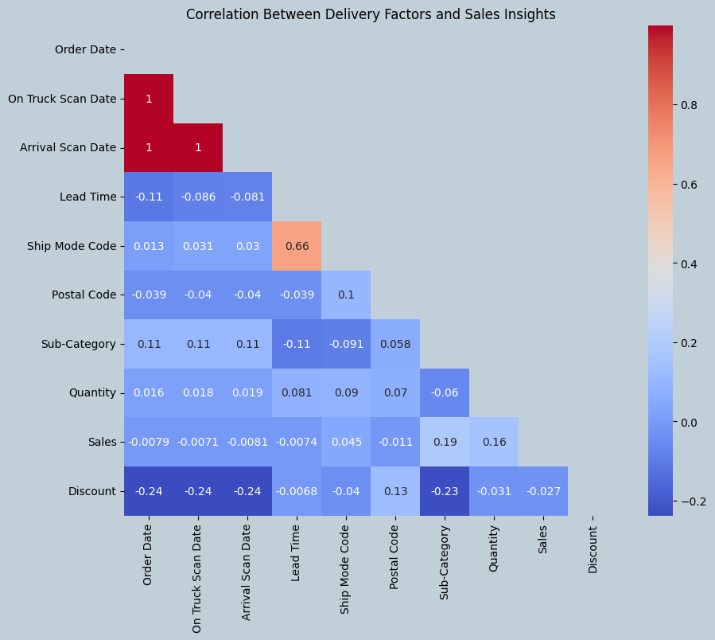
Understanding Delivery Delays

Slide 5
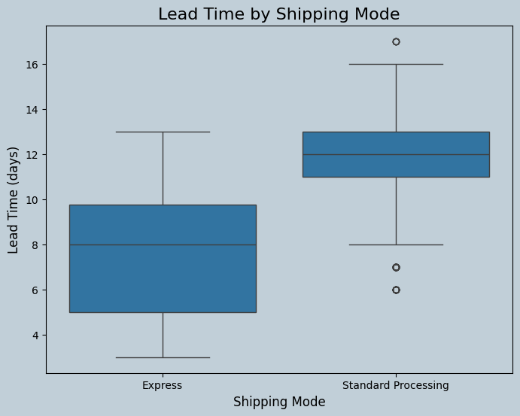
Shipping Mode Comparison

Slide 6
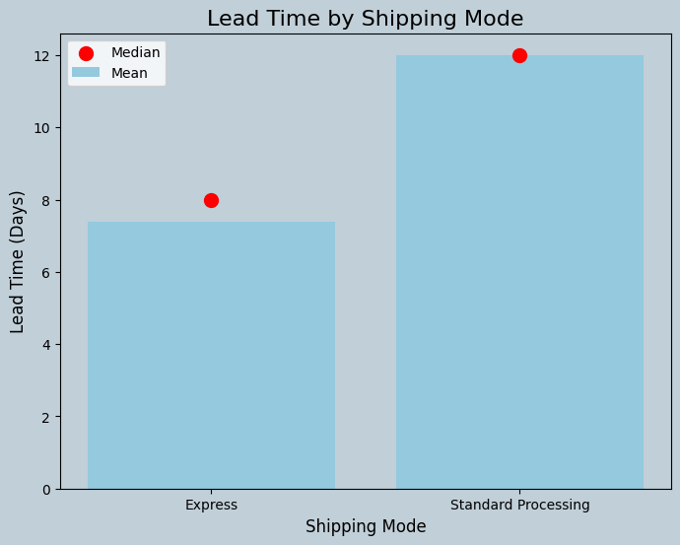
Shipping Mode Comparison

Slide 7
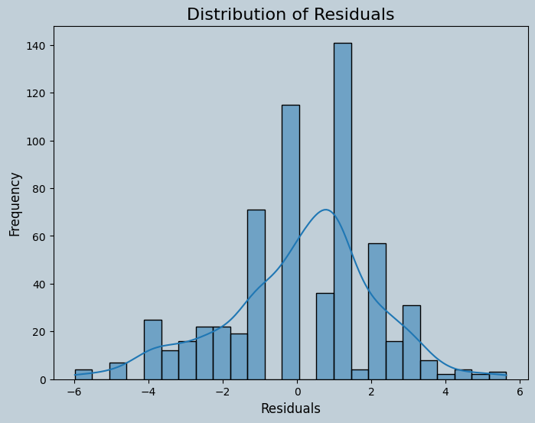
Predictive Modeling for Lead Time

Slide 8
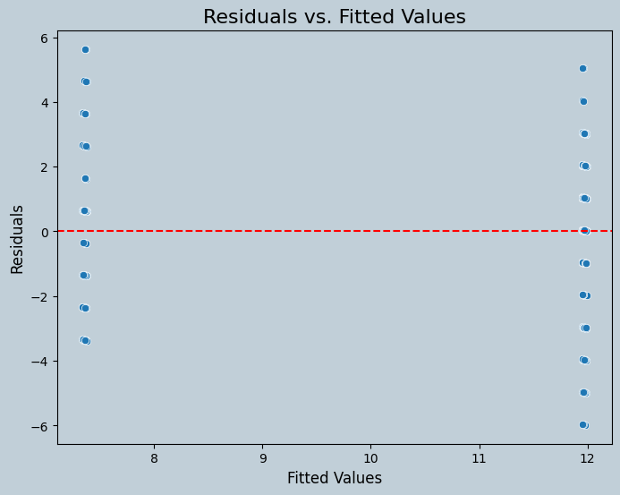
Predictive Modeling for Lead Time

Slide 9
Ship Mode Summary Statistics

Slide 10
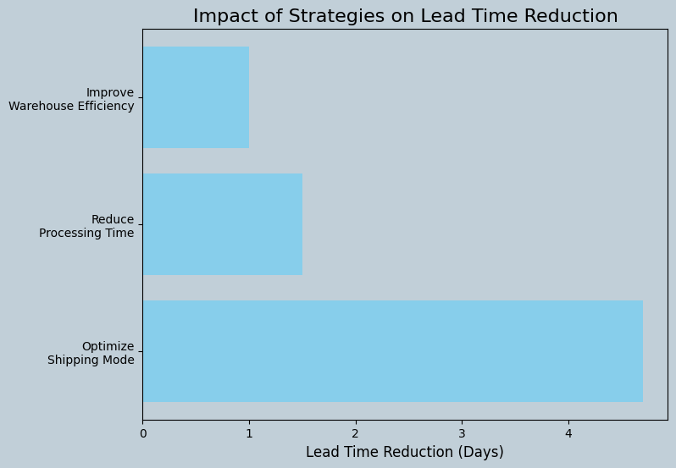
Strategic Recommendations

Slide 11
THANK YOU

